Slide 1
Angular
Introduction

Slide 2
Know what Angular is, creating a first Angular Application

Slide 3
Agenda
Introduction
Getting Started
Angular CLI
Project Overview
Debug Tools
Dependency Injection

Slide 4

Introduction
Client Side Web Development Framework by
Leverages HTML and CSS to create rich data-enable web applications
Open Source
Web: http://angular.io
GitHub: https://github.com/angular/angular

Slide 5


vs

Slide 6
vs
just angular

Slide 7
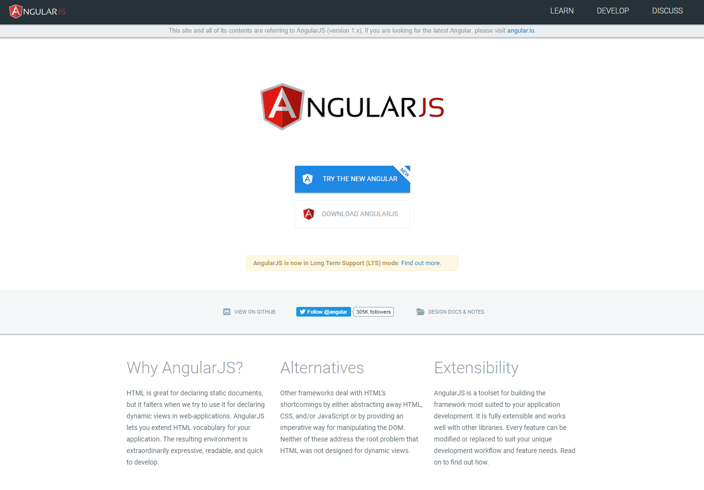

Slide 9
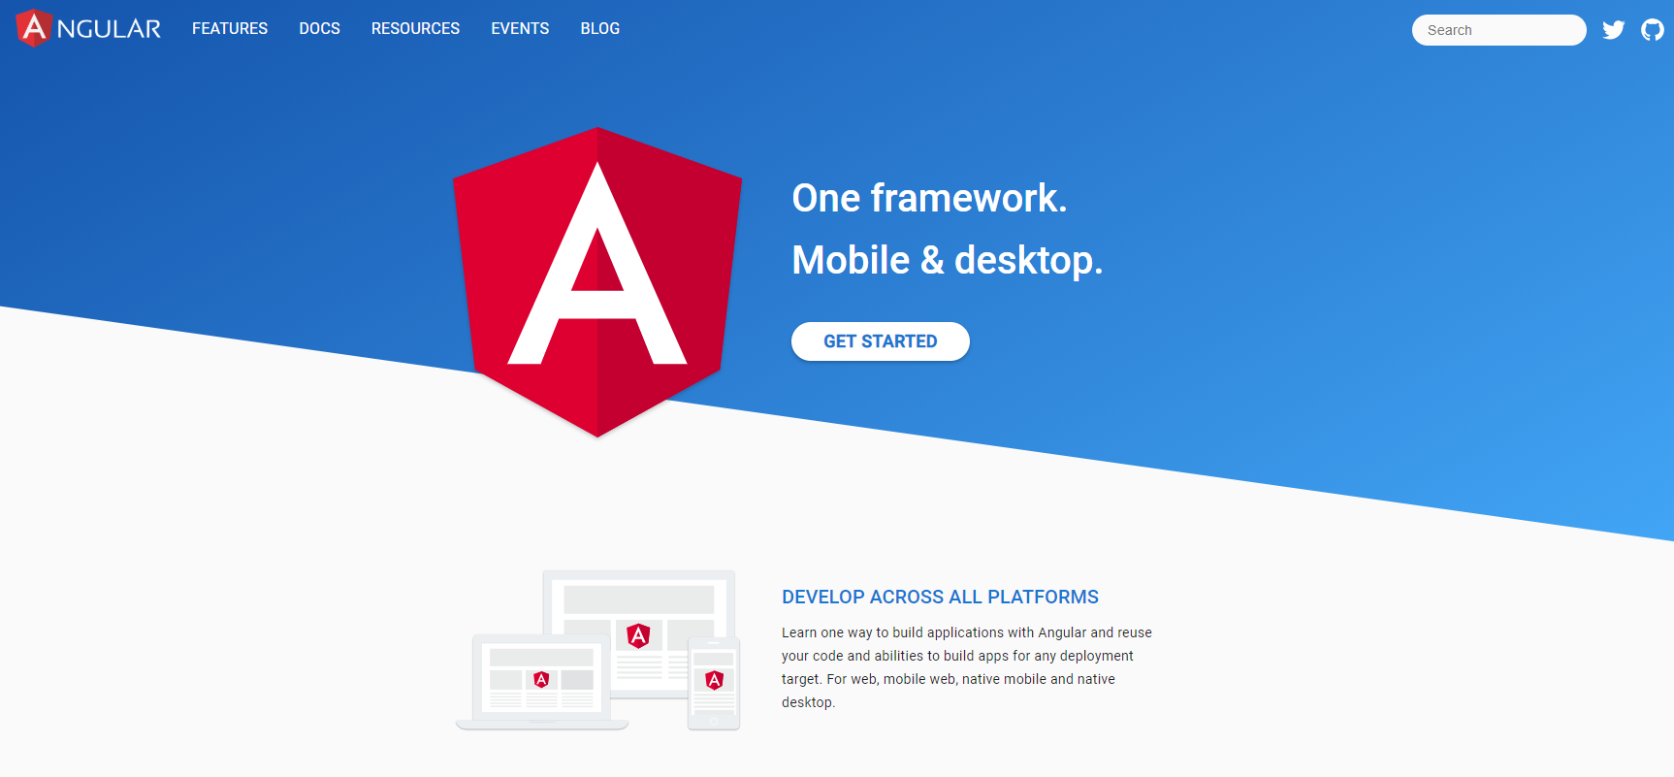

Slide 10
Take a step back
Angular 1 and Angular 2+ are different frameworks
Sometimes it is better to start with 2 instead of following the logical steps
Treat them different
Angular 1
Not OK for modern web application development
Cannot not be compiled to native code
Doesn’t play wel on other environments
Works with the existing DOM

Slide 11
Take a step back
Angular 1 and Angular 2+ are different frameworks
Sometimes it is better to start with 2 instead of following the logical steps
Treat them different
Angular 2+
To fix the limitations of Angular 1, Google had to rewrite the framework
Achieve cross-platform rendering
Speed

Slide 12
Important for Angular
Data Binding & Formatting
Network Communication
Routing and navigation
MVC pattern
Easy to extend
Easy to test

Slide 13
Why should you care?
A lot of JavaScript code is needed to create these kind of websites

Slide 14
Why should you care?
will save your day!!

Slide 15
Angular
1
Getting started

Slide 16
Angular CLI
Command-line interface tool to work with Angular applications
Initialize
Develop
Scaffold
Maintain
https://angular.io/cli
Install via npm or yarn
global
npm install -g @angular/cli

Slide 17
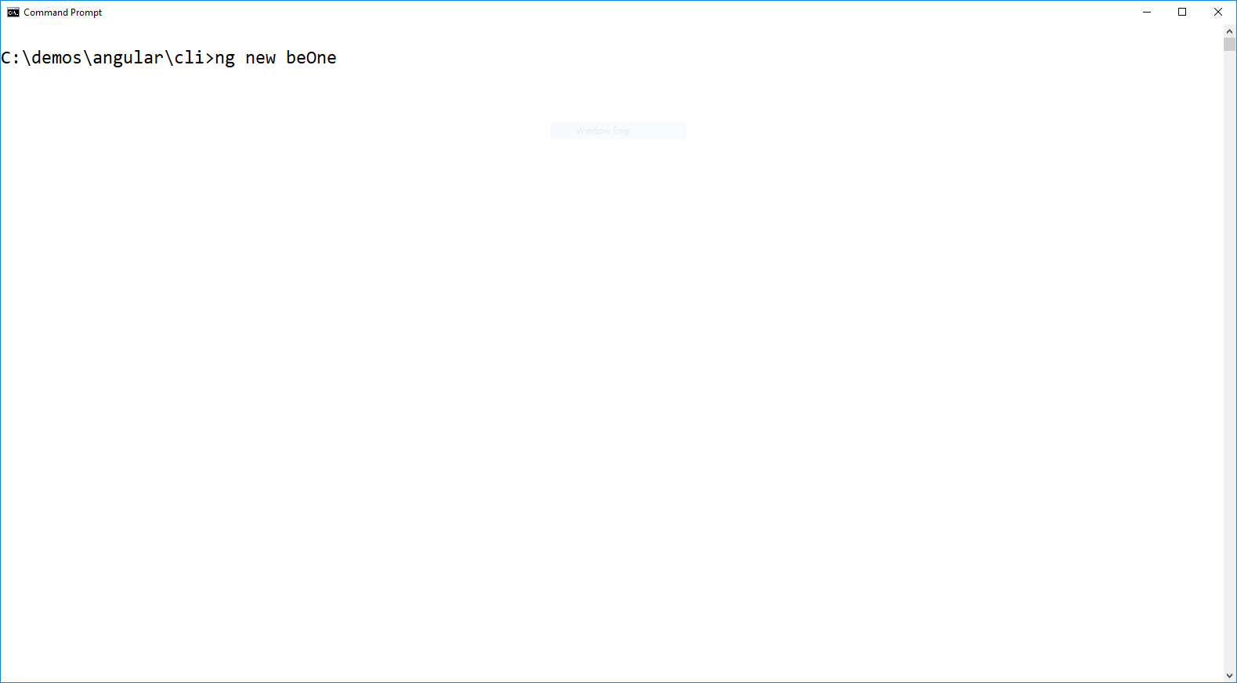
Create a new Angular application
Create a new Angular application

Slide 18
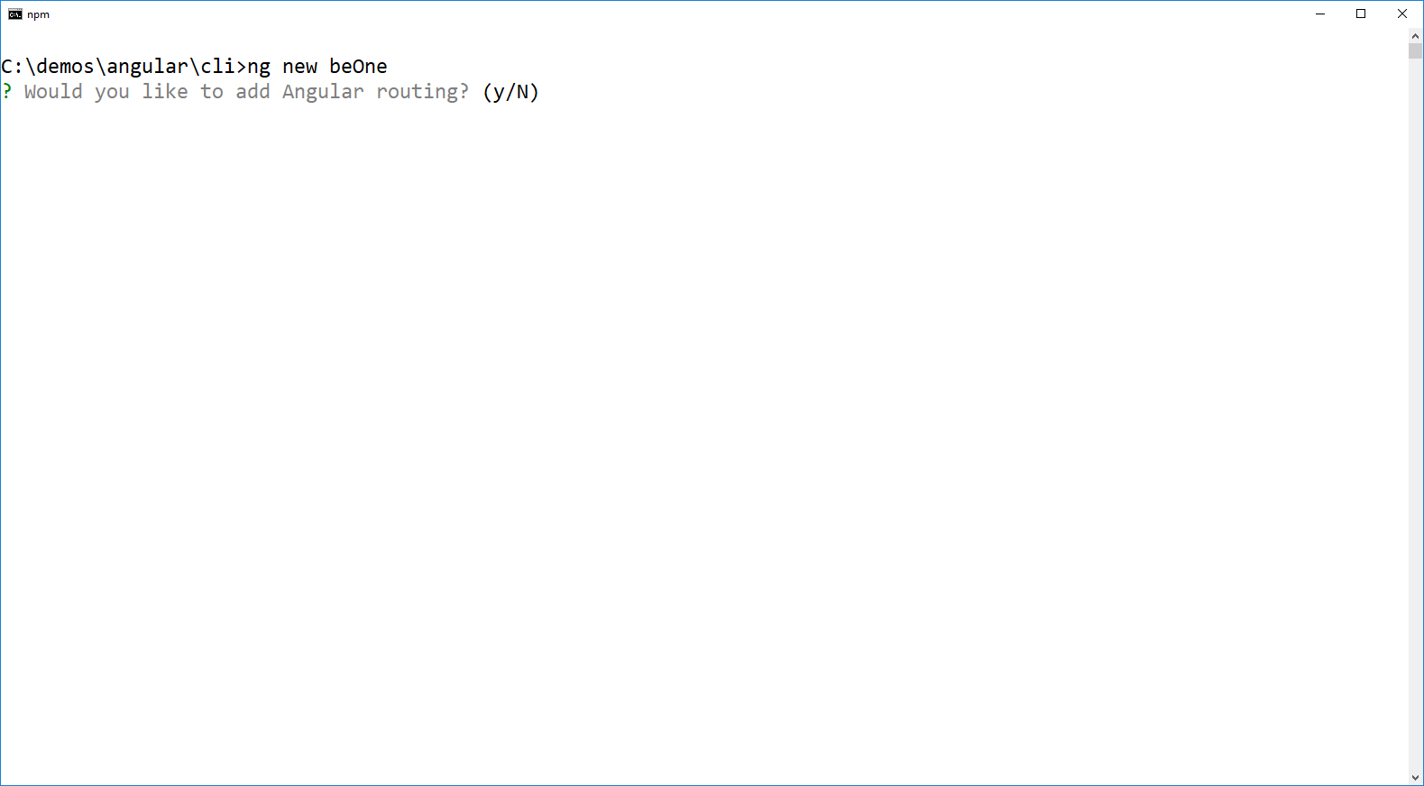
Create a new Angular application
Angular is modular, not everything is by default installed

Slide 19
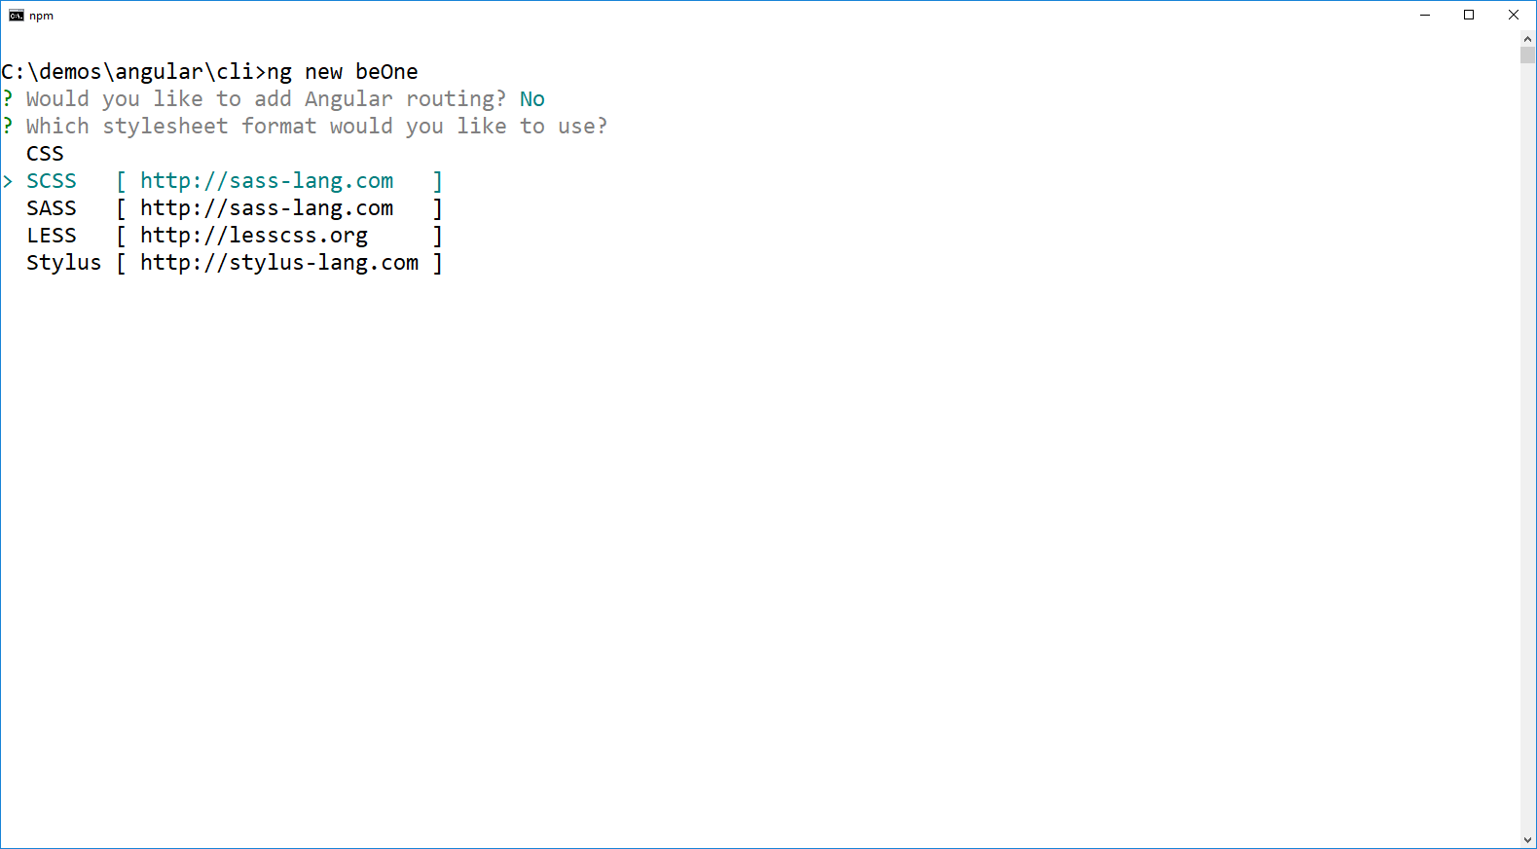
Create a new Angular application
Use CSS or a CSS pre-processor
We will use SCSS

Slide 20
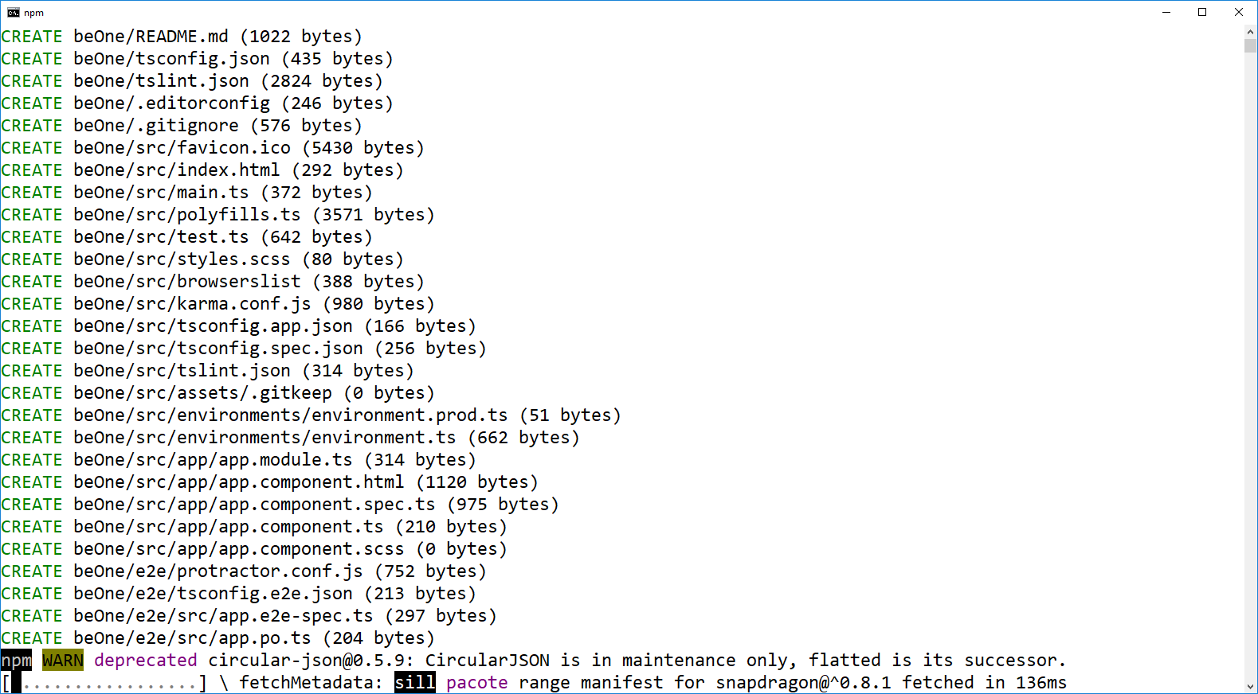
Create a new Angular application
Grab a coffee, everything is getting installed

Slide 21
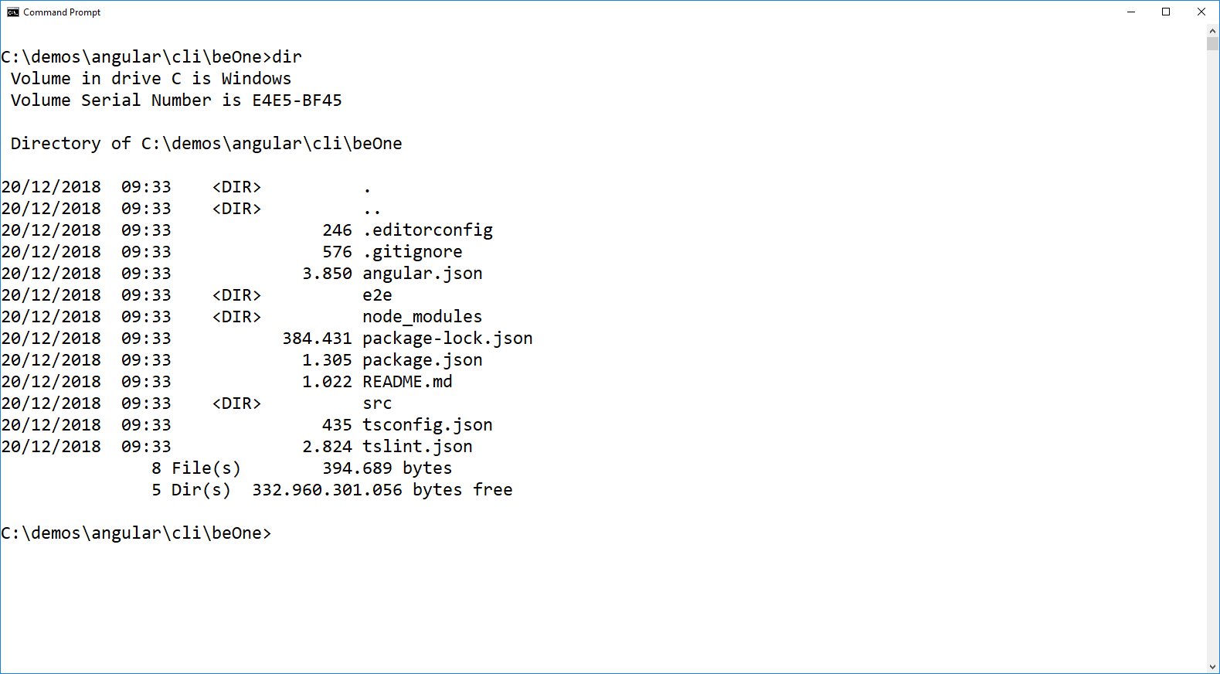
Create a new Angular application
Done

Slide 22
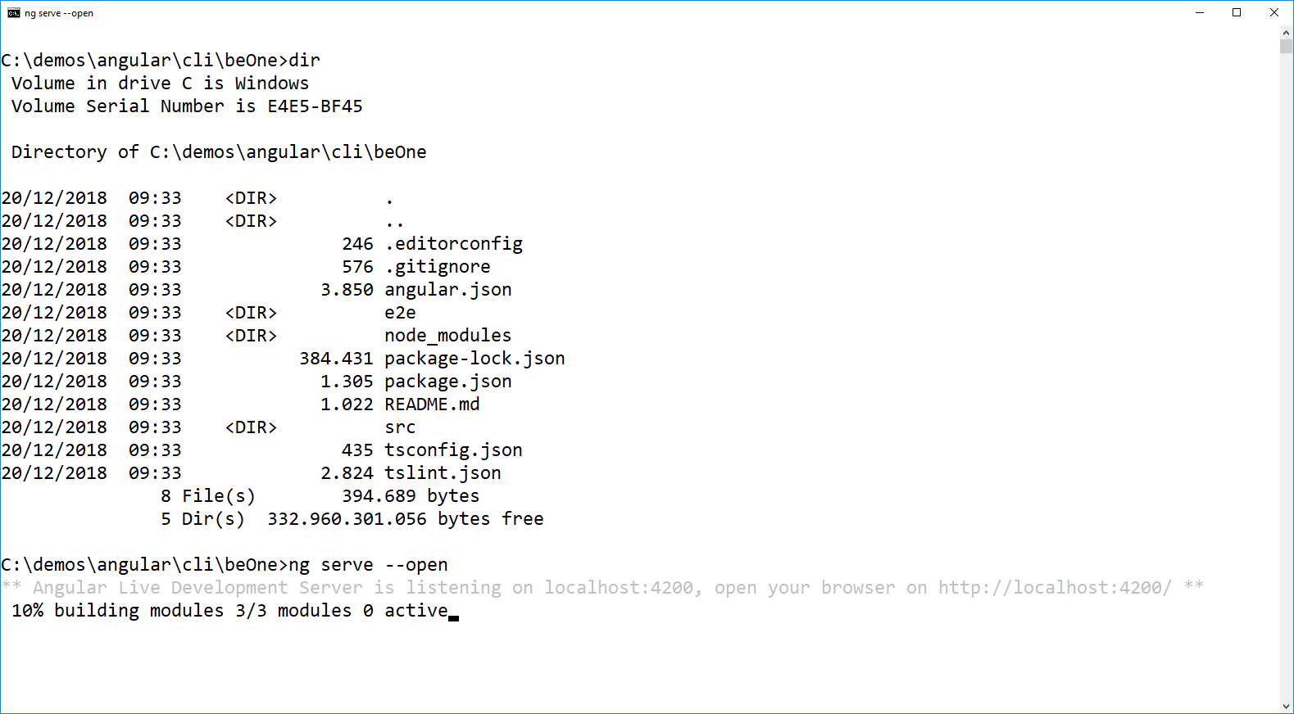
Create a new Angular application
Check your new Angular application

Slide 23
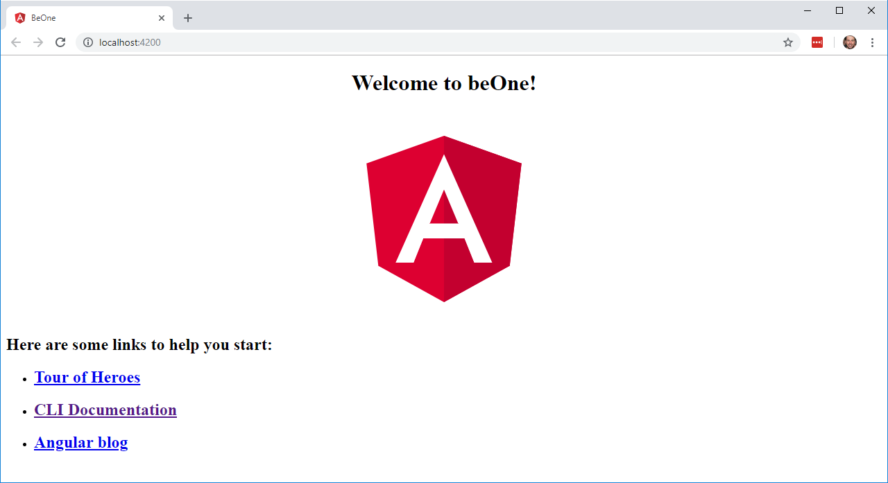
Create a new Angular application

Slide 24
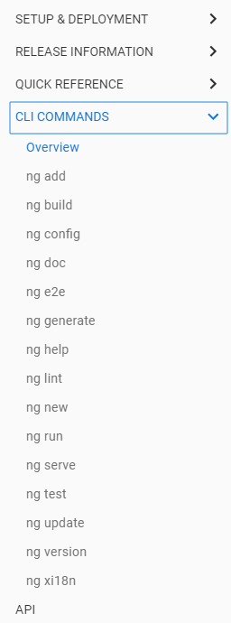
CLI Commands that will make your life easier

Slide 25
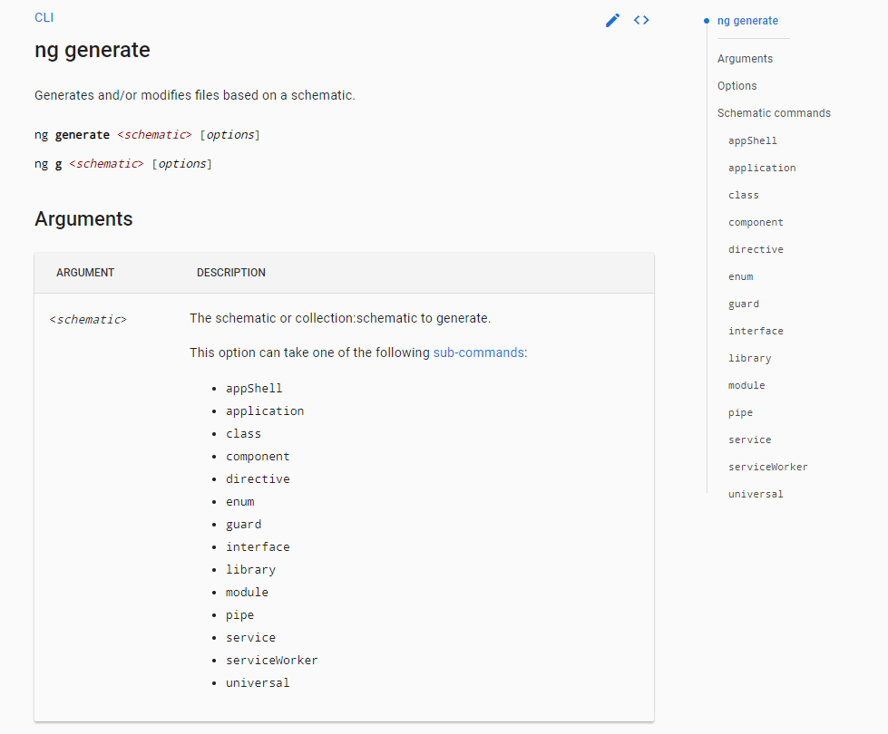

Slide 26
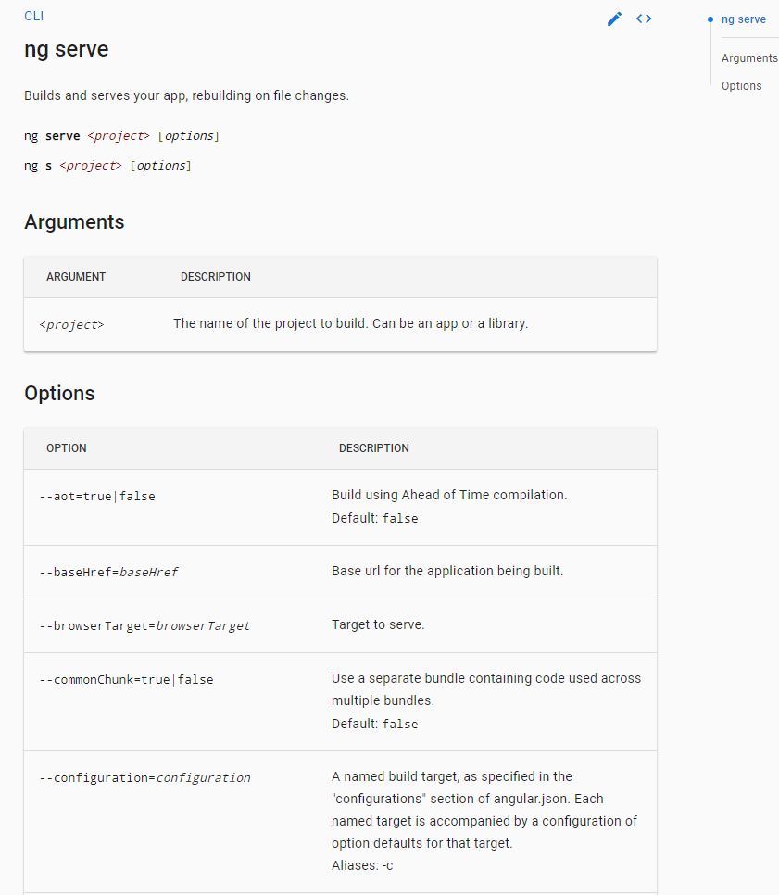

Slide 27
Angular
2
Project Overview

Slide 28
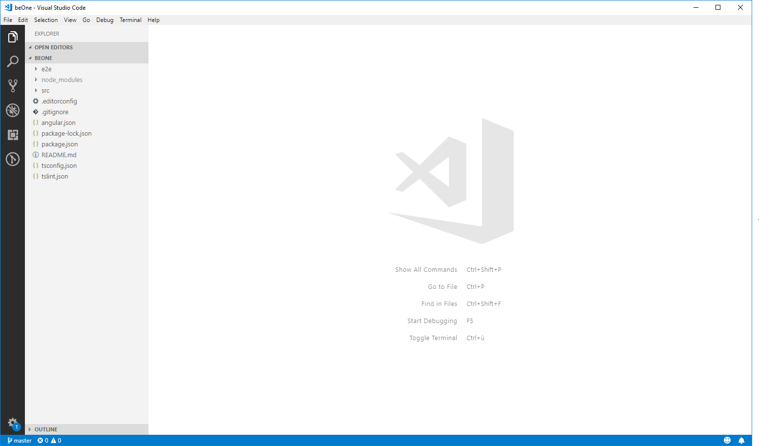

Slide 29
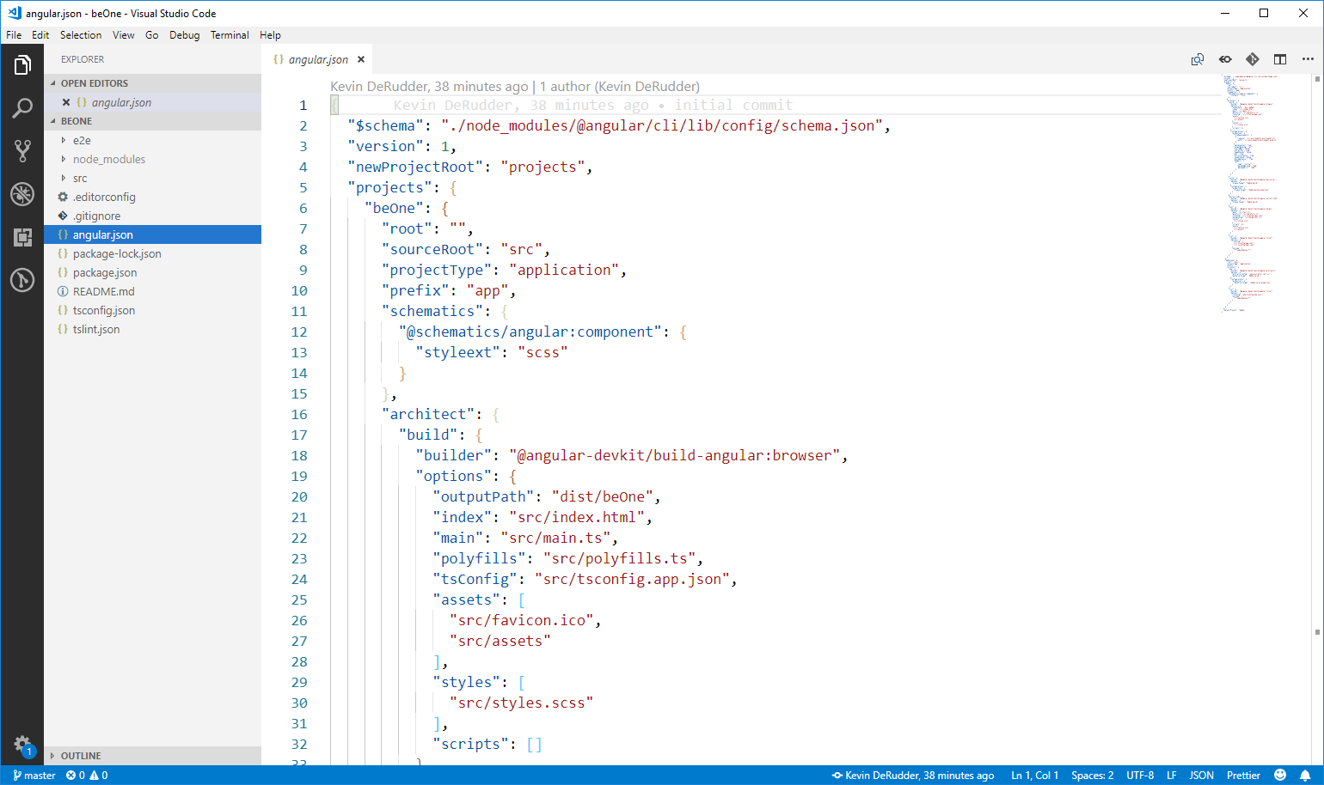
angular.json or angular workspace file
replaces the angular-cli.json file
Directory which is generated via Angular CLI and able to contain multiple projects or libraries that derive the configuration out of a single file.
uses angular schematics
Notes:
https://nitayneeman.com/posts/understanding-the-angular-cli-workspace-file/

Slide 30
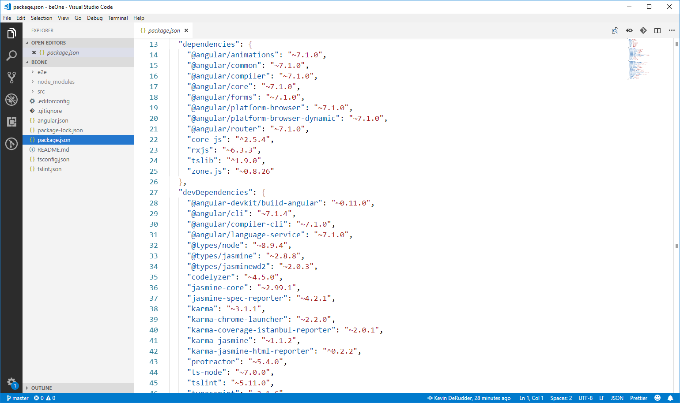
Needed during execution
Needed during development

Slide 31
Needed during execution
Needed during development

Slide 32
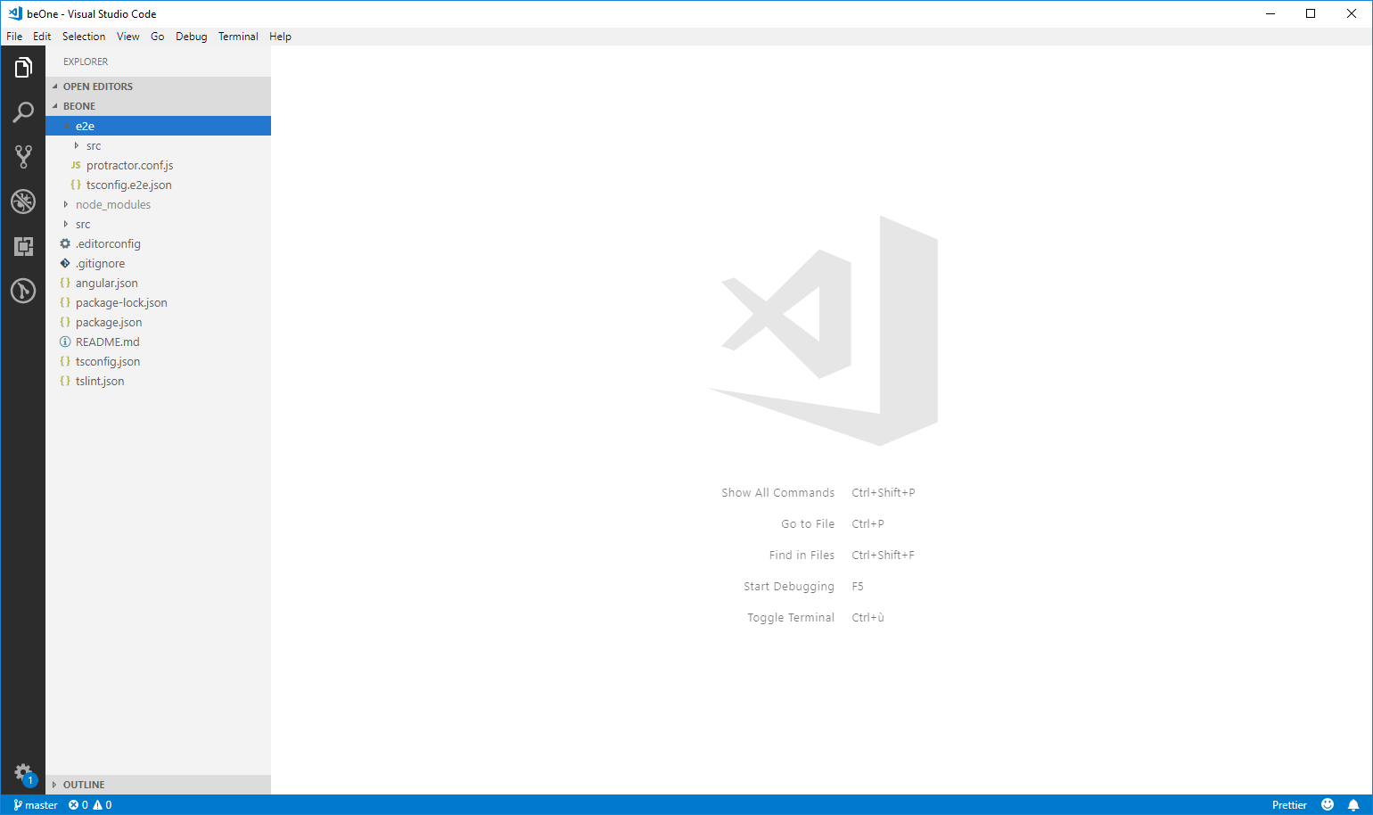
End 2 End or Integration Testing folder
To make sure at a high-level overview that our applications function correctly
Notes:
https://coryrylan.com/blog/introduction-to-e2e-testing-with-the-angular-cli-and-protractor

Slide 33
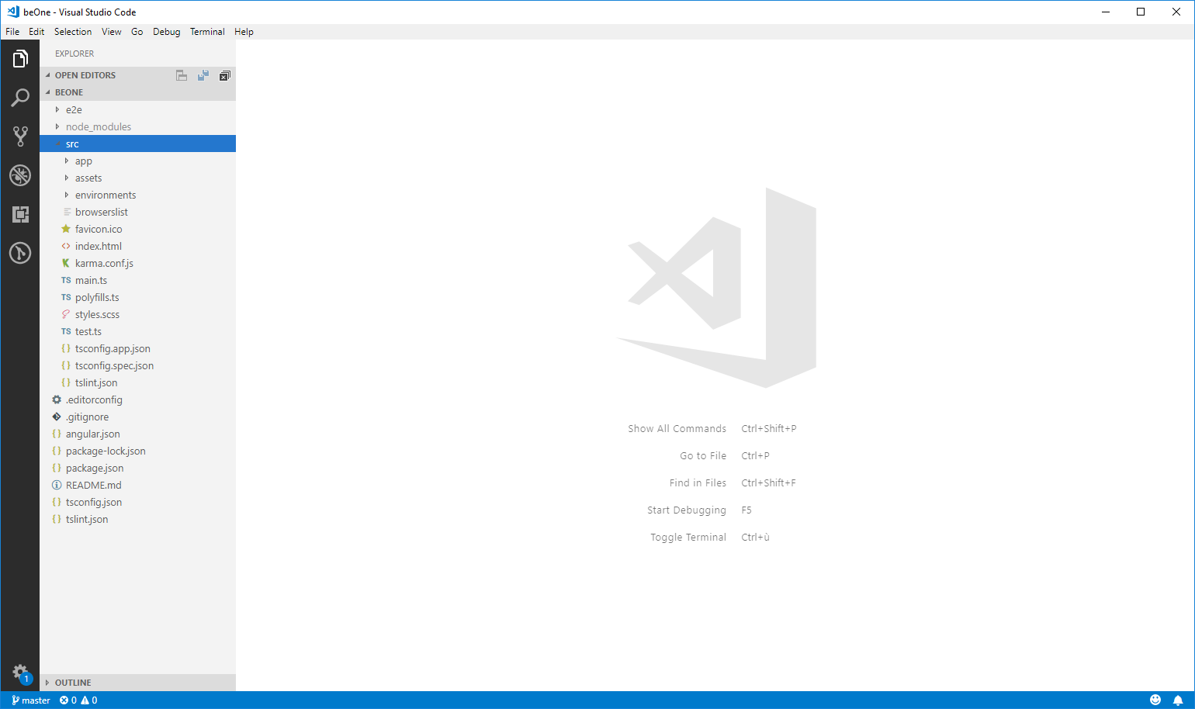
Where the magic happens

Slide 34
Contains component files with your application logic

Slide 35
Contains image files and other asset files to be copied as-is when you build your application.

Slide 36
Contains build configuration options for particular target environments

Slide 37
Configures sharing of target browsers and Node.js versions among various front-end tools

Slide 38
Angular
3
Debug Tools
Notes:
https://medium.com/front-end-weekly/a-guide-to-debugging-angular-applications-5a36bd88b4cf

Slide 39
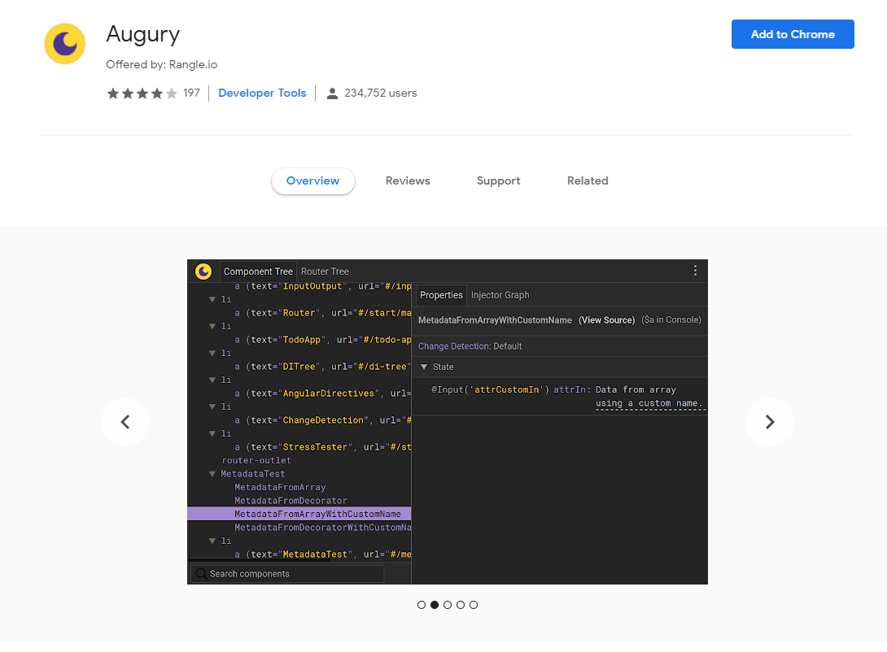

Slide 40
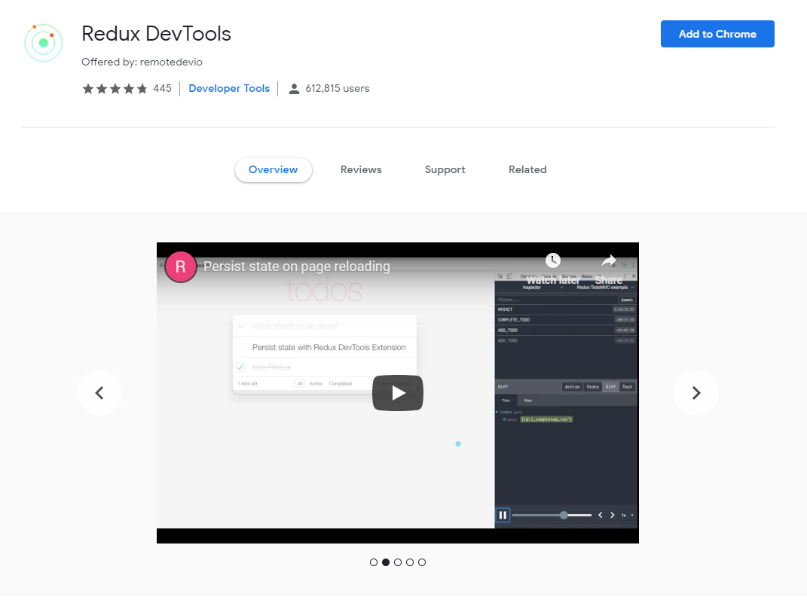

Slide 41
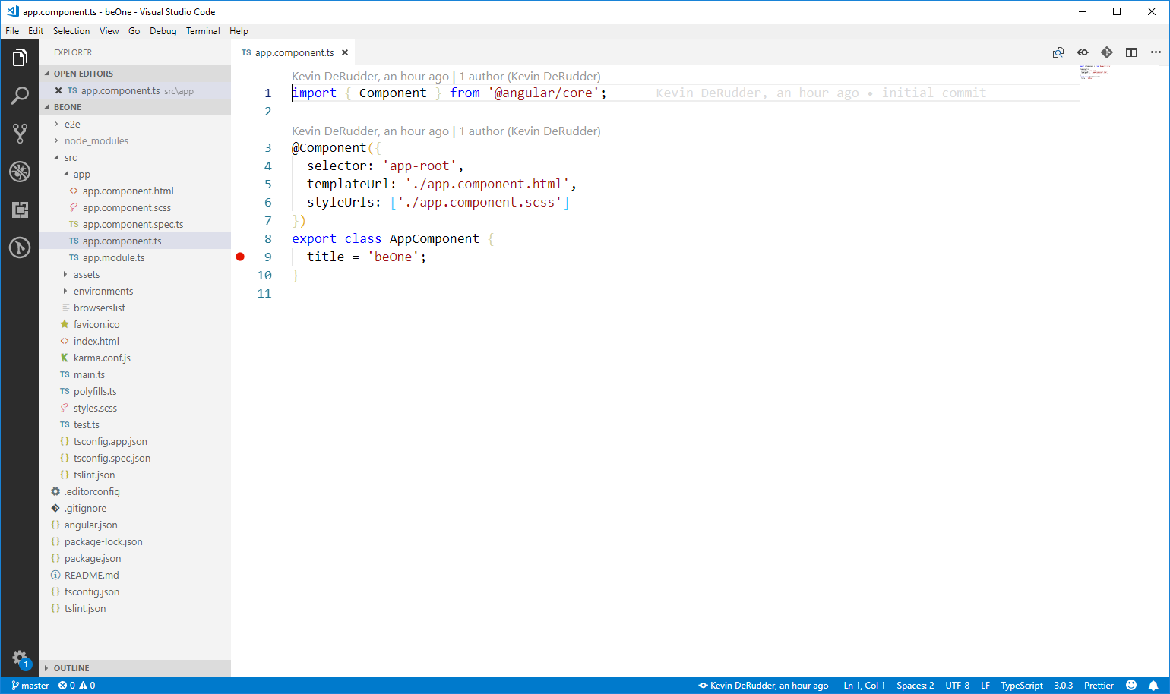

Slide 42
Angular
4
How Angular works
Notes:
https://medium.com/front-end-weekly/a-guide-to-debugging-angular-applications-5a36bd88b4cf

Slide 43
The Angular application
ngModule
Module system to organize the code
Bootstraps the angular application
AppComponent

Slide 44
The Angular application
An Angular application is a tree of Components
the top level component is the application
will be rendered by the browser
BeOne
Navigation
Customers
Login
Customer row
Customer row
Customer row

Slide 45
The Angular application
The UI is rendered by defining a template
HTML
CSS
Events
Combination of custom templates and built-in templates

Slide 46
The Angular application
Modules
Components
Templates
Data Binding
Dependency Injection
Services
Metadata
Directives

Slide 47
Angular
5
Dependency Injection
Notes:
https://medium.com/front-end-weekly/a-guide-to-debugging-angular-applications-5a36bd88b4cf

Slide 48
What is a dependency
Module A
Module B

Slide 49
What is a dependency
Module A
Module B
import { B } from 'B';
Requires module B to run

Slide 50
What is a dependency
Module A
Module B
import { B } from 'B';
Dependency

Slide 51
Being
Dependent?

Slide 52
Being
Dependent?
How do you Mock B during testing
Share a single instance across your app
...

Slide 53
Dependency Injection
Defines how and when objects are created
Make parts of the application accessible for other parts of the application
Dependency Injection in angular
Built-in
Client component is not responsible for creating dependencies

Slide 54
Example
Calculate price of a product after sales tax
Create a service
Use the service
Service calculates tax

Slide 55
1. TaxService
export class TaxService{
constructor(){}
calcTotalPrice(price: number){
const tax = 1.21;
return price * tax;
}
}

Slide 56
2. Use TaxService
import { TaxService } from './tax.service';
export class Product{
service: TaxService;
price: number;
constructor(price: number){
this.service = new TaxService();
this.price = price;
}
get TotalPrice(){
return this.service.calcTotalPrice(this.price);
}
}
Dependency
Hard coded

Slide 57
We want to make a service available without relying on a specific implementation

Slide 58
describe what your service needs to do
We want to make a service available without relying on a specific implementation

Slide 59
We want to make a service available without relying on a specific implementation
Configure angular to provide the functionality

Slide 60
Describe what your service needs to do
Create an interface
Implement the interface
export interface ITaxService{
calcTotalPrice(price: number):number;
}
export class TaxService implements ITaxService{

Slide 61
Implement the interface
Class gets a service via the constructor
export class Product{
service: TaxService;
price: number;
constructor(service: ITaxService, price: number){
this.service = service;
this.price = price;
}
get TotalPrice(){
return this.service.calcTotalPrice(this.price);
}
}

Slide 62
Angular’s Dependency Injection system
To make it work, you have to:
Register the dependency
Describe how the dependency will be injected
Inject the dependency
How
Singleton?
Multiple creations?

Slide 63
Dependency Injection Parts
If you want to use a dependency you need a token to point to the dependency
Like a URL for an api
Dependency injection has 3 pieces
Provider
Injector
Dependency

Slide 64
Dependency Injection Parts
Provider
Injector
Token
Dependency
registers
resolves
Dependency Registry

Slide 65
Providing depedencies
Use ngModule to register what we’ll inject
Providers
Use decorators to specify what we’re injecting
@NgModule({
declarations: [AppComponent],
imports: [BrowserModule],
providers: [TaxService],
bootstrap: [AppComponent]
})

Slide 66
Providers
You must configure ngModule for Dependency Injection to work
Different ways we can configure resolving injected dependencies
Inject a singleton
Inject a value
Call any function and inject the return value of that function

Slide 67
Singleton instance of a class
Most common type of injection
Is shorthand syntax for:
providers: [TaxService]
providers: [{
provide: TaxService, useClass: TaxService
}]

Slide 68
Singleton instance of a class
Most common type of injection
Is shorthand syntax for:
providers: [TaxService]
providers: [{
provide: TaxService, useClass: TaxService
}]
token
how

Slide 69
Inject a value
Use a value throughout your application
Like a global constant
providers: [
{ provide: 'API_URL', useValue: 'http://...'}
]
import { Inject } from '@angular/core';
export class TaxService{
constructor(@Inject('API_URL') url: string){
}
}

Slide 70
Factories
What happens if a service’s constructor requires arguments?
Factory: a function that can return any object when injected
providers: [
{
provide: TaxService,
useFactory(){
// whatever you return is used
}
}
]

